Slide 1
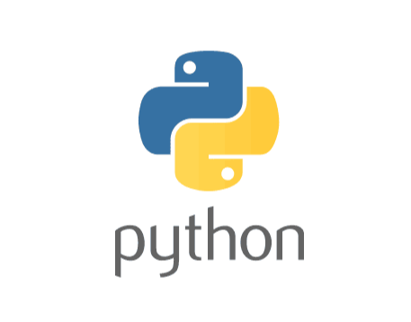
Session : 2

Slide 2



Variables
Variables in programming act as placeholders or containers for storing data
Like labeled boxes where you can put different types of information
Each variable has a name (like a label on the box) and a value (what's inside the box)
a3
a1
a2

Slide 3
Variables play a crucial role in programming by allowing to store and manipulate data dynamically
Python is a dynamically typed language, allowing flexible variable declaration and assignment
Variables are created by assigning a value to a name, with no need to specify a data type explicitly
Syntax: variable_name = value
Example: age = 30

Slide 4
Python Variables Naming Conventions
Use Descriptive Names
camelCase or Underscore
Avoid Reserved Words

Slide 5
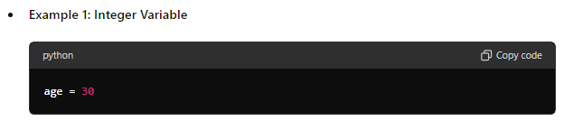
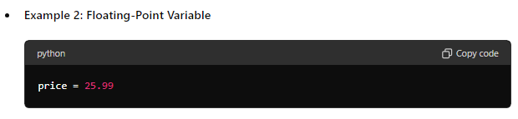
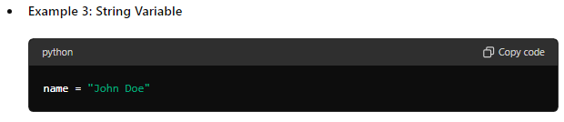
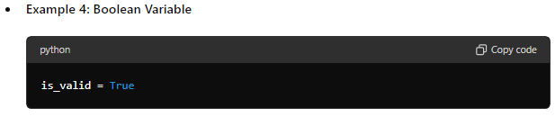
Variables/ Data Types and Examples

Slide 6


Typecasting
Process of converting data from one data type to another
Implicit Conversion: In some cases, the language automatically converts data from one type to another.
Explicit Conversion: Programmers can explicitly convert data types using built-in functions or casting syntax provided by the language
Common Conversion Functions :
int(), float(), str(), bool()

Slide 7

Why typecasting is required?
What are the two types of typecasting?

Slide 8
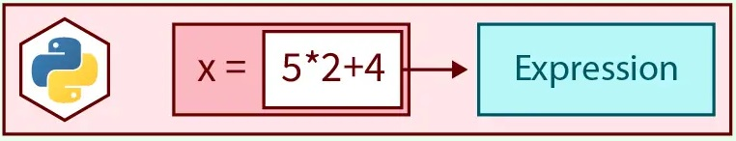
EXPRESSIONS
Combination of values, variables, and operators that evaluates to a single value

Slide 9





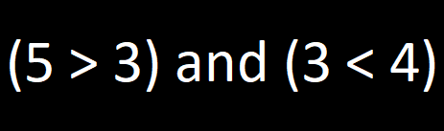
Types of Expressions
Arithmetic expressions
Constant expressions
Floating-point expressions
Integral expressions
Comparison expressions
Logical expressions

Slide 10

ACTIVITY
Create a program that checks if a number entered by the user is even or odd

Slide 11
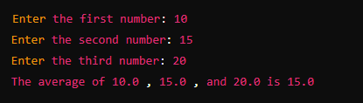
ACTIVITY
Create a program that takes three numbers as input and calculates their average

Slide 12

HOME TASK
Create a Python program that converts Celsius to Fahrenheit
fahrenheit = (celsius * 9/5) + 32

